Slide 1

INFO5002 - Intro to Python for Info Sys Final Project
Submitted on: April 24, 2023 Submitted by: Luna Yumiki

Slide 2
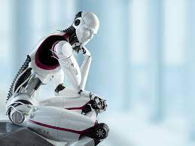
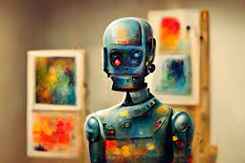
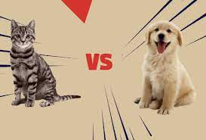

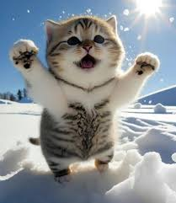
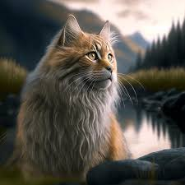
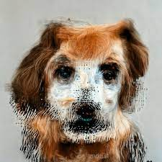
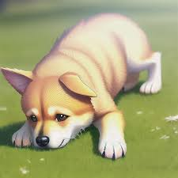
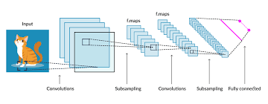
Introduction
Interaction between AIs – Image Recognition
I can tell what is in the picture, dog or cat!
I can generate pictures
Build the ML model
Test AI-2’s images with AI-1 model

Slide 3
Introduction
Interaction between AIs – Image Recognition
Our final project is to build an intelligent image classifier by using machine learning method - Cat and Dog Classification Model. This model can accurately identify whether an image is a cat or a dog.
We also built a program to let the machine automatically create cat/dog images to test our model.

Slide 4
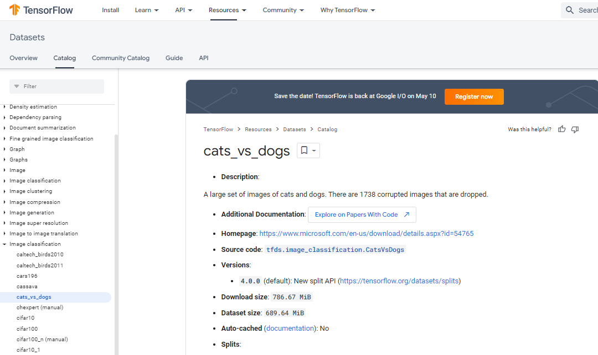
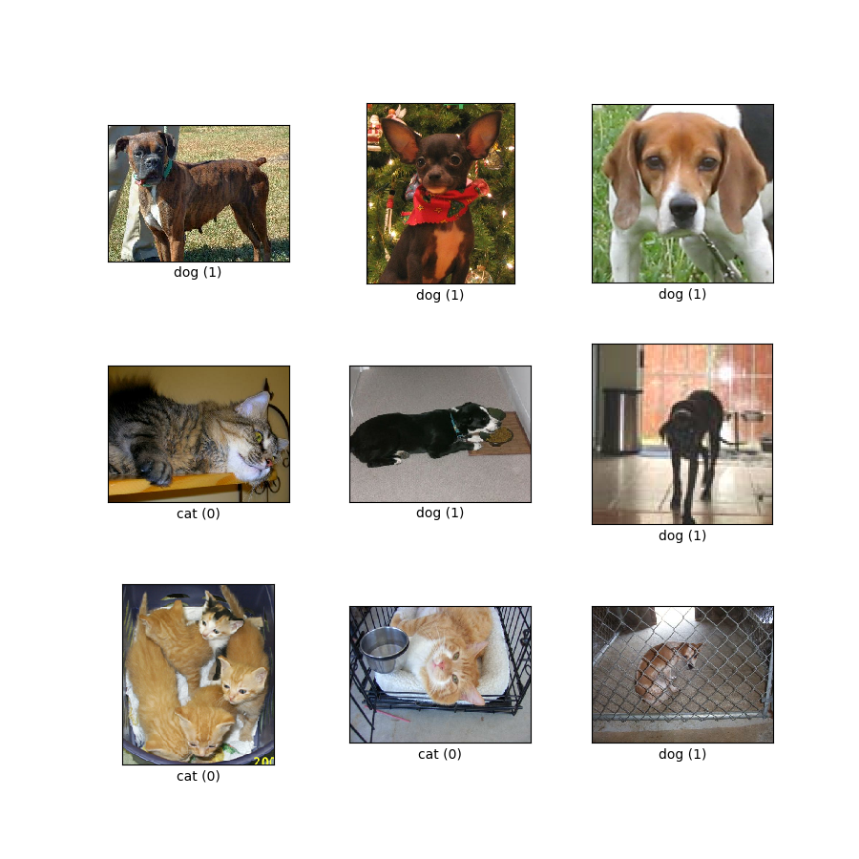
Cat & Dog Raw/Input Dataset
We used a classical dataset (by Microsoft) of cats and dogs to train the model.
The raw dataset contains >10K images, we just manually picked ~2000 from it

Slide 5
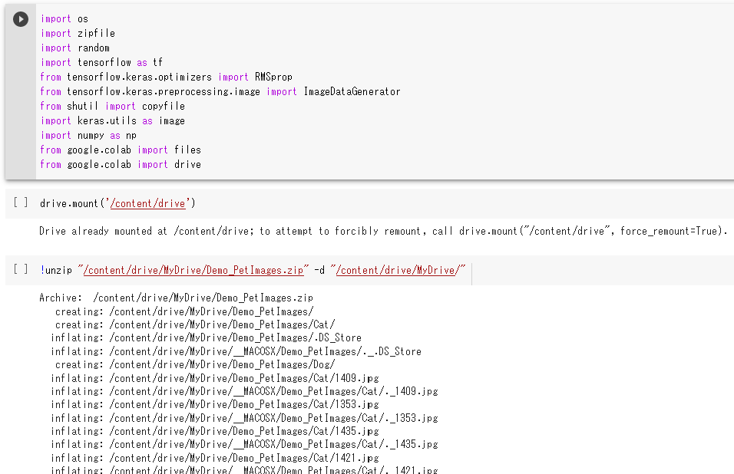
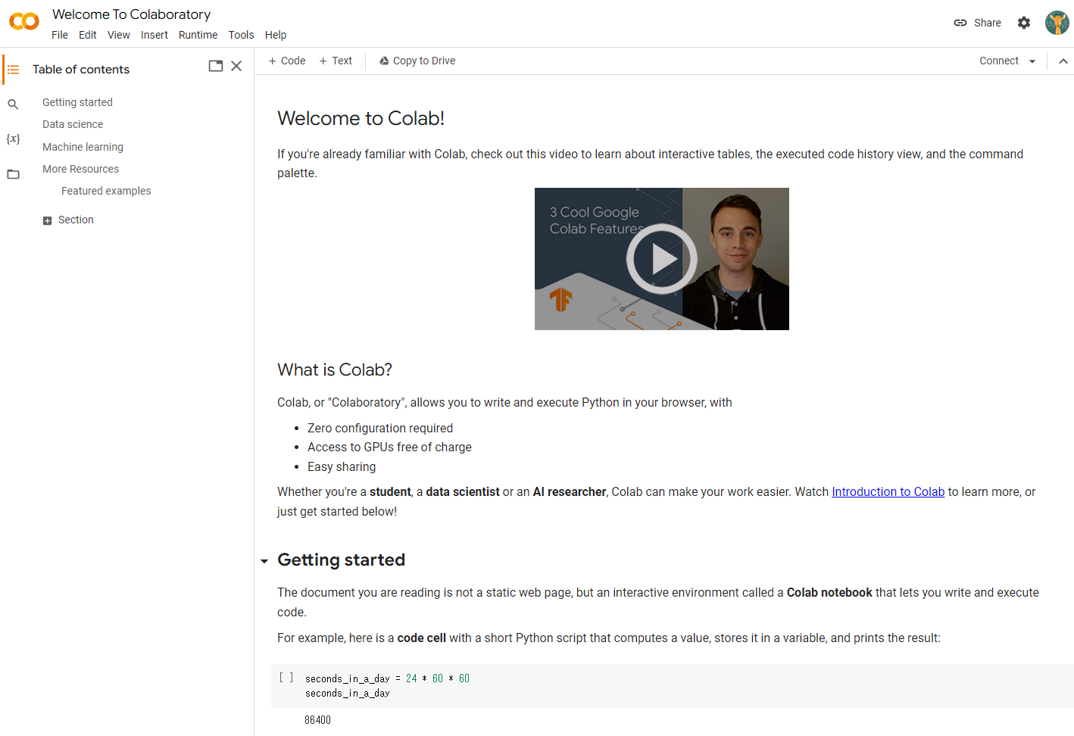
Model Training Platform – Google Colab
We used Google Colab for running the python code

Slide 6
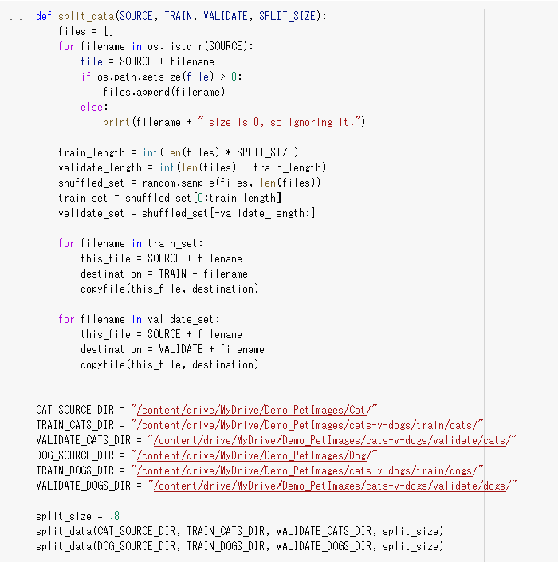
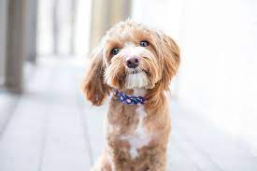
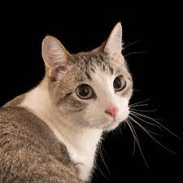
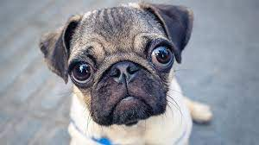
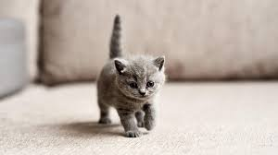
Model Training – Data Processing
Raw data : 1000 dog images + 1000 cat images
We then preprocessed the data by TRAIN vs. VALIDATE split
TRAIN
VALIDATE
200 dogs
200 cats
800 dogs
800 cats
predict
80%
evaluate
20%

Slide 7
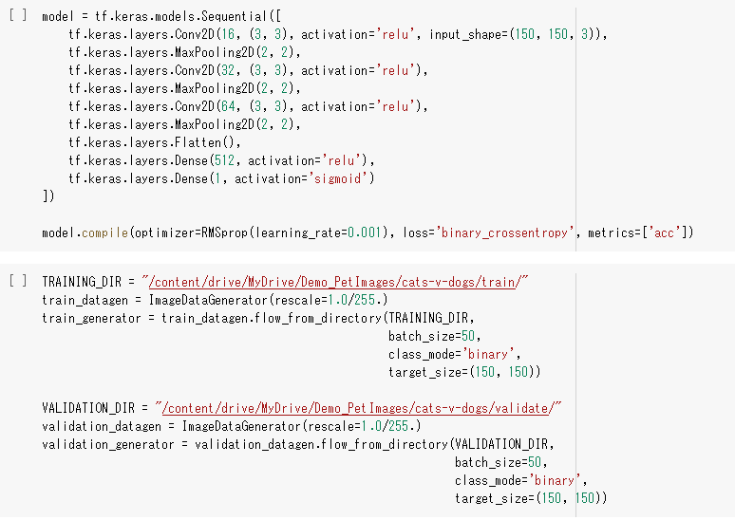
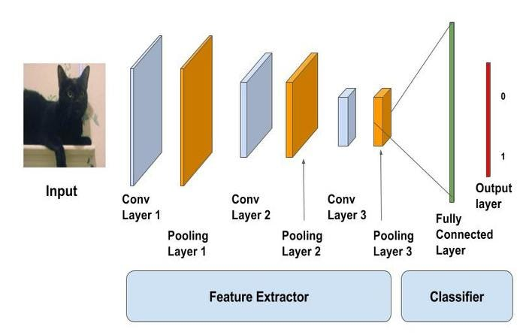
Model Training – CNN Architecture
We used a convolutional neural network (CNN) architecture to train our model. This architecture is well-suited for image recognition tasks and has been shown to achieve high accuracy in similar projects.

Slide 8
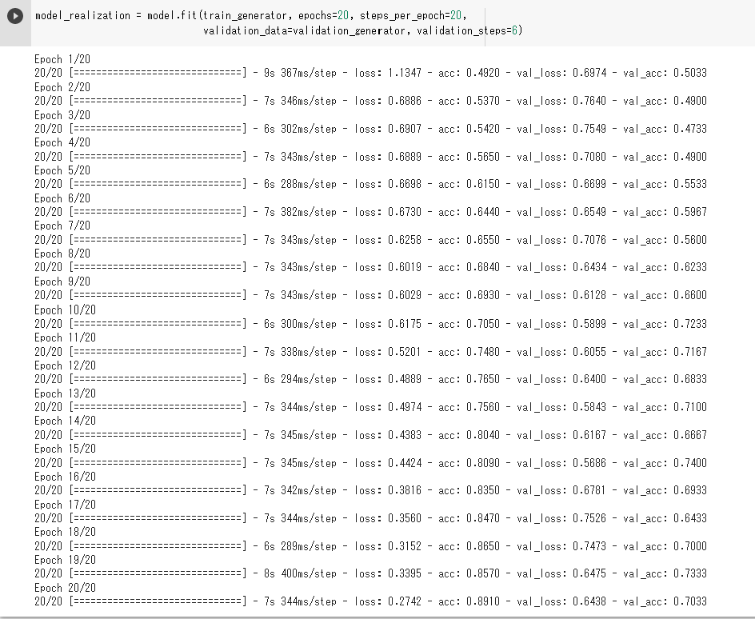
Model Training – Iterative Improvement
Epoch: one full cycle through the training dataset – feed the 1600 images to the model.
Steps_per_epoch – 20 rounds to feed the images (each round feed 80=1600/20 images)
After 20 rounds of training and validation, our model achieved an accuracy of 90%/70% on the train/validate set, which is a significant improvement from our initial baseline model.

Slide 9

Create Image - Pre Trained Model
Stable Diffusion Model
Text to Image
Generating photo-realistic images given any text input

Slide 10
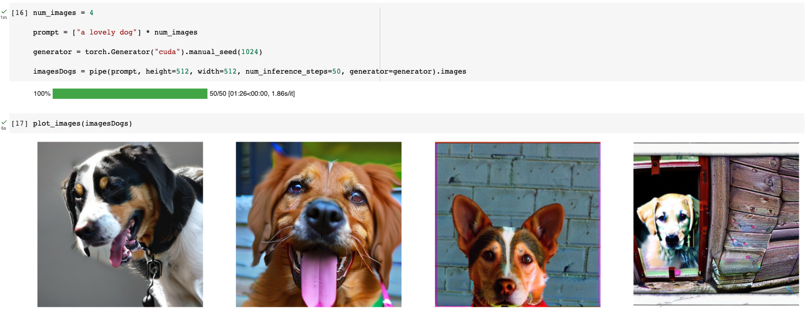
Create Image - Pre Trained Model
generate “a lovely dog”

Slide 11
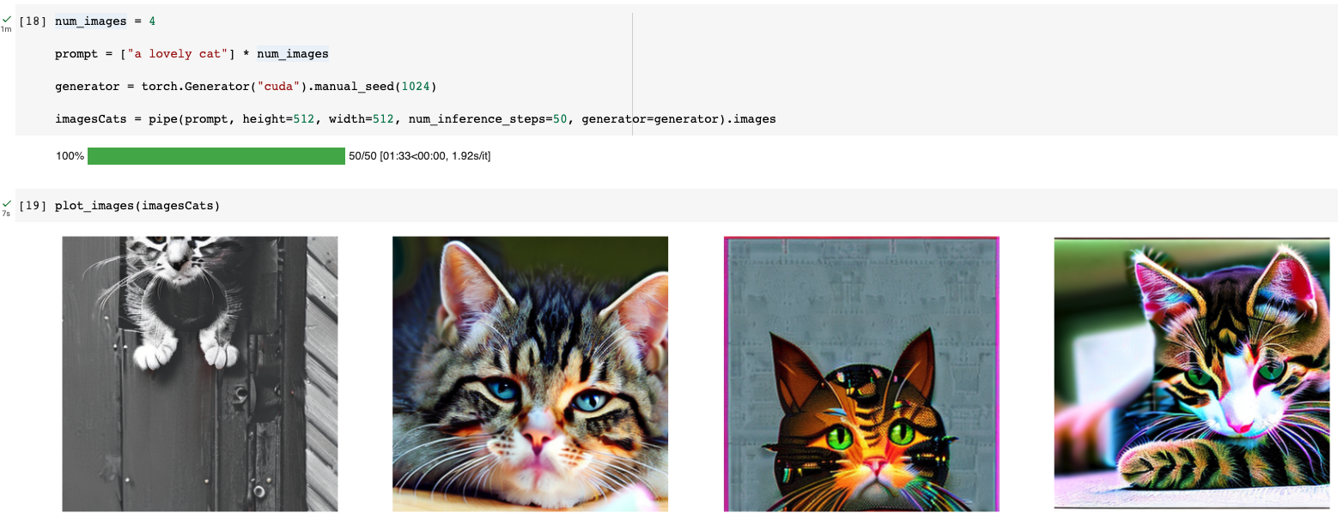
Create Image - Pre Trained Model
generate “a lovely cat”

Slide 12
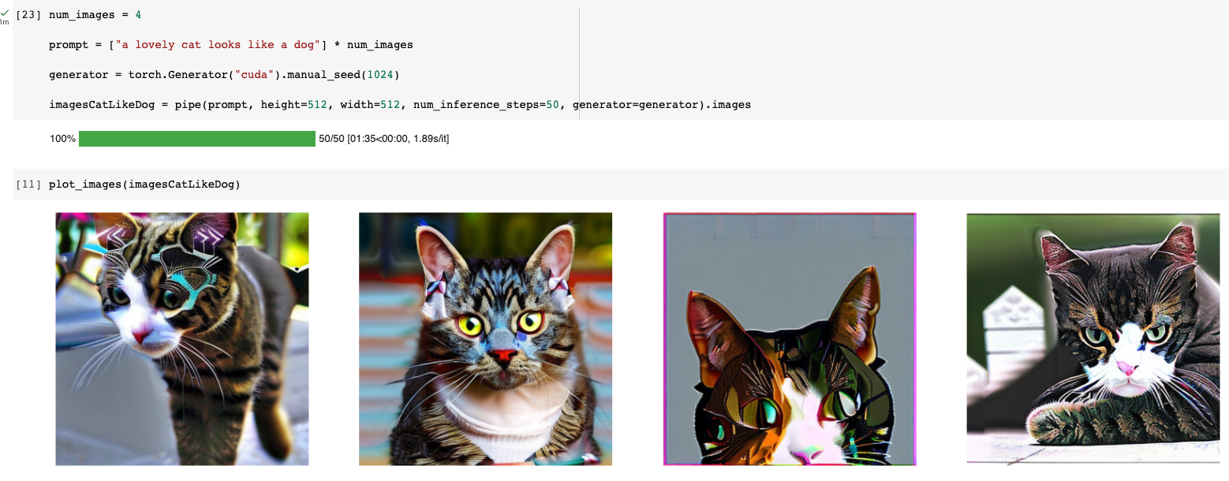
Create Image - Pre Trained Model
generate
“a lovely cat looks like a dog”

Slide 13
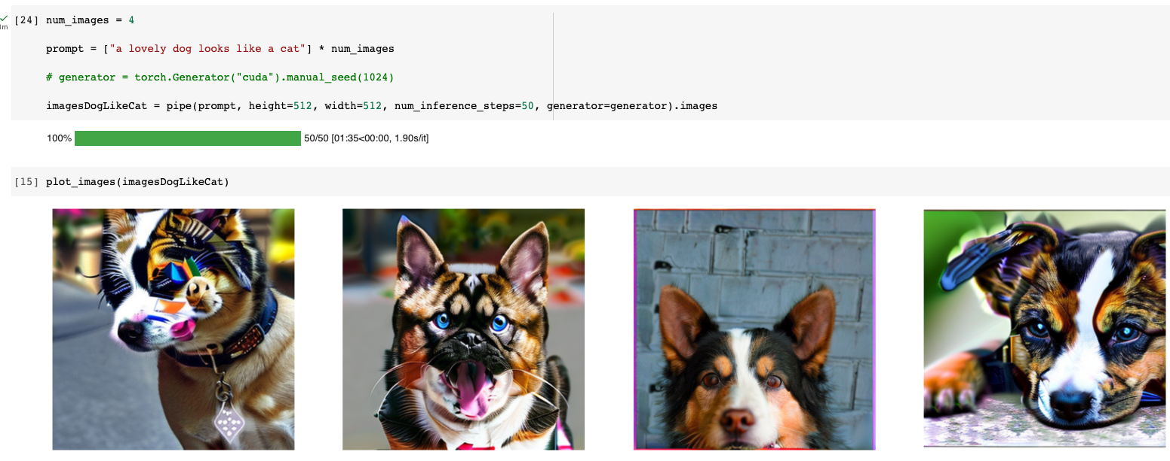
Create Image - Pre Trained Model
generate
“a lovely dog looks like a cat”

Slide 14
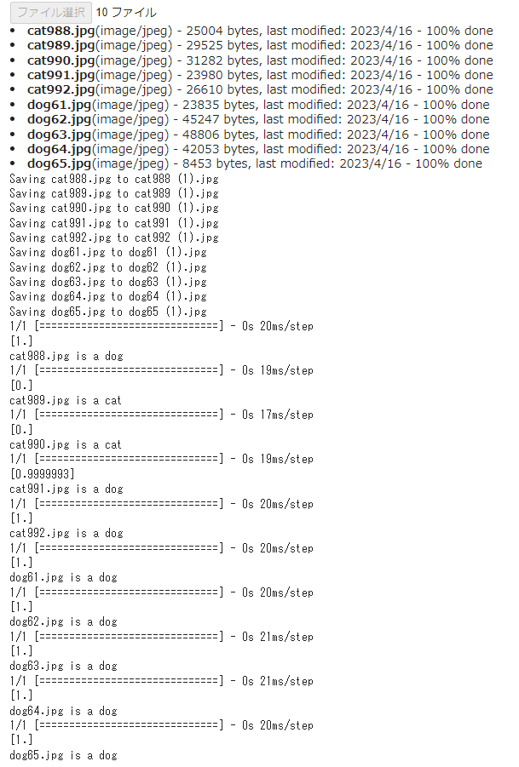
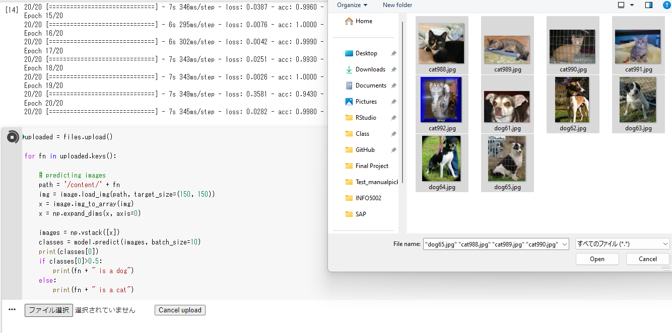


Evaluation – Manual Picked Images

Slide 15
Reference
https://stablediffusionweb.com/
https://github.com/HabanaAI/Model-References/tree/master/PyTorch/generative_models/stable-diffusion-v-2-1

